Slide 1
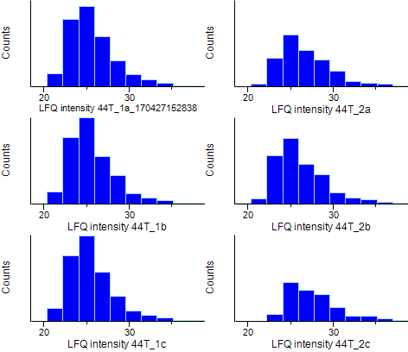
1 vs 2
Pre imputation histograms

Slide 2
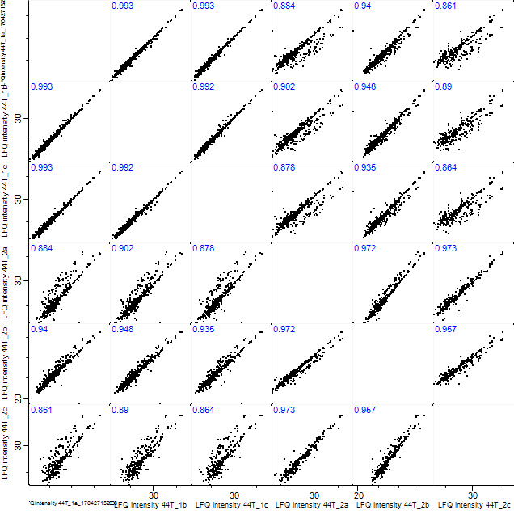
1 vs 2

Slide 3
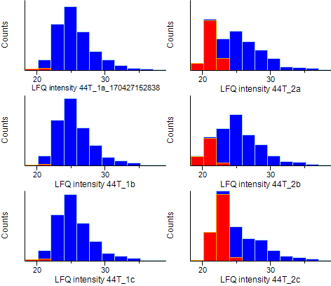
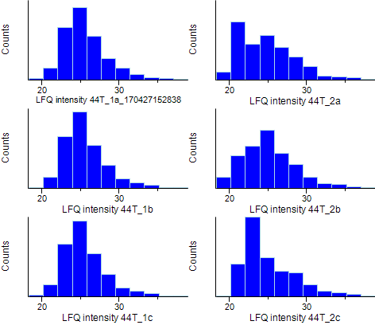
1 vs 2
Post imputation histograms (imputed in red)

Slide 4
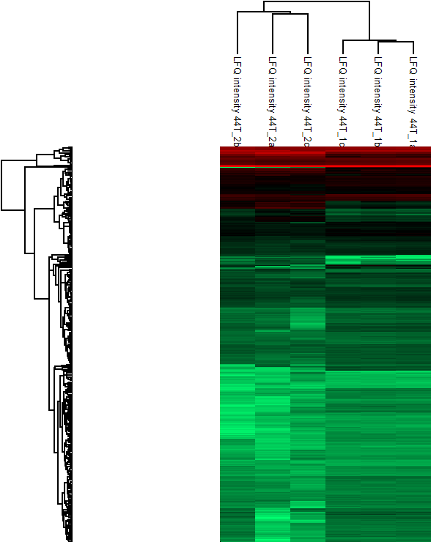
1 vs 2

Slide 5
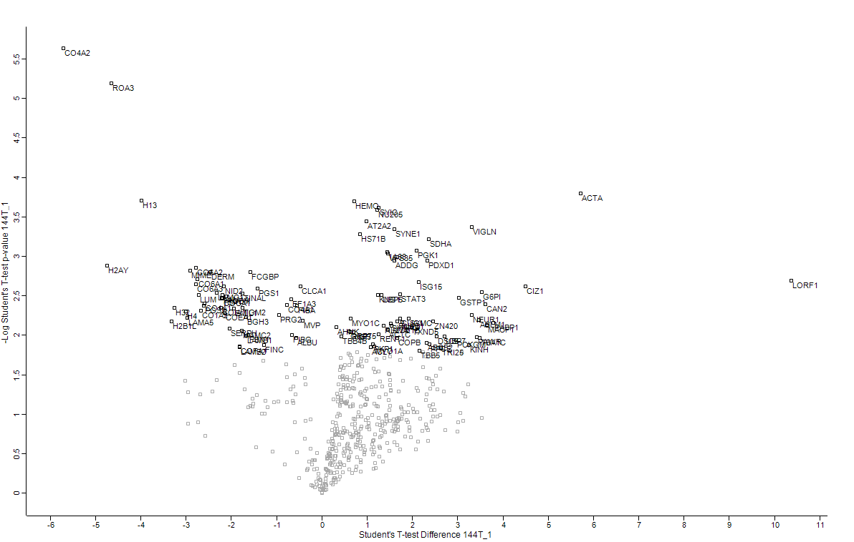
1 vs 2

Slide 6
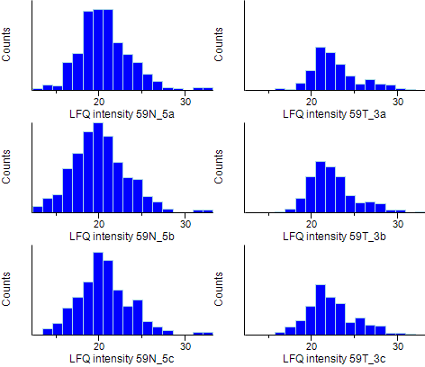
3 vs 5
Pre imputation histograms

Slide 7
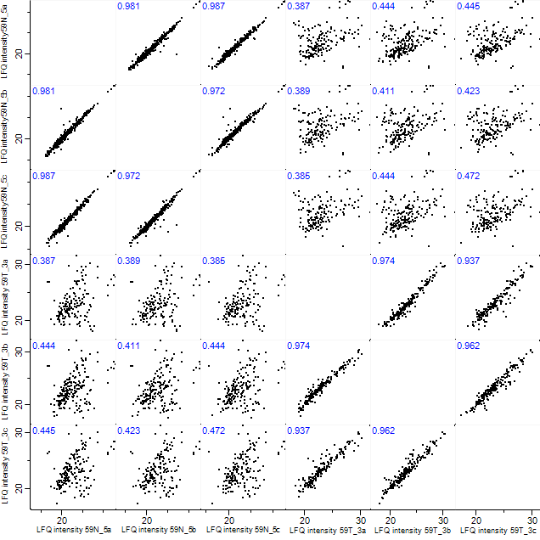
3 vs 5

Slide 8
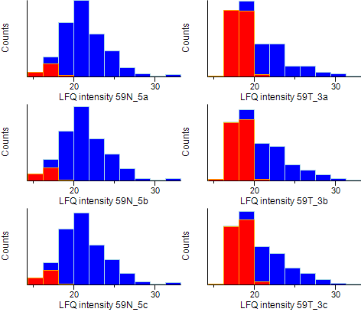
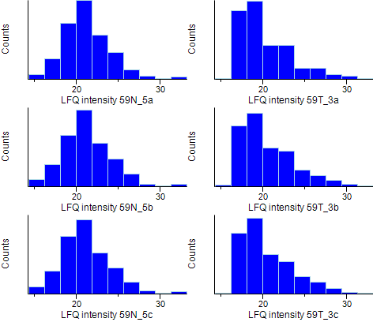
3 vs 5
Post imputation histograms (imputed in red)

Slide 9
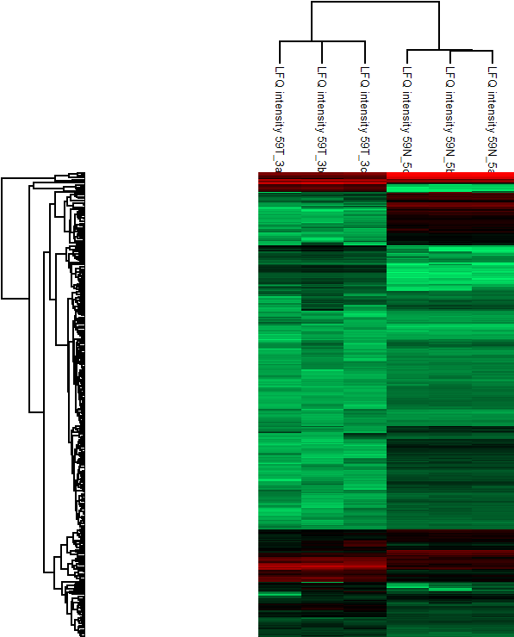
3 vs 5

Slide 10
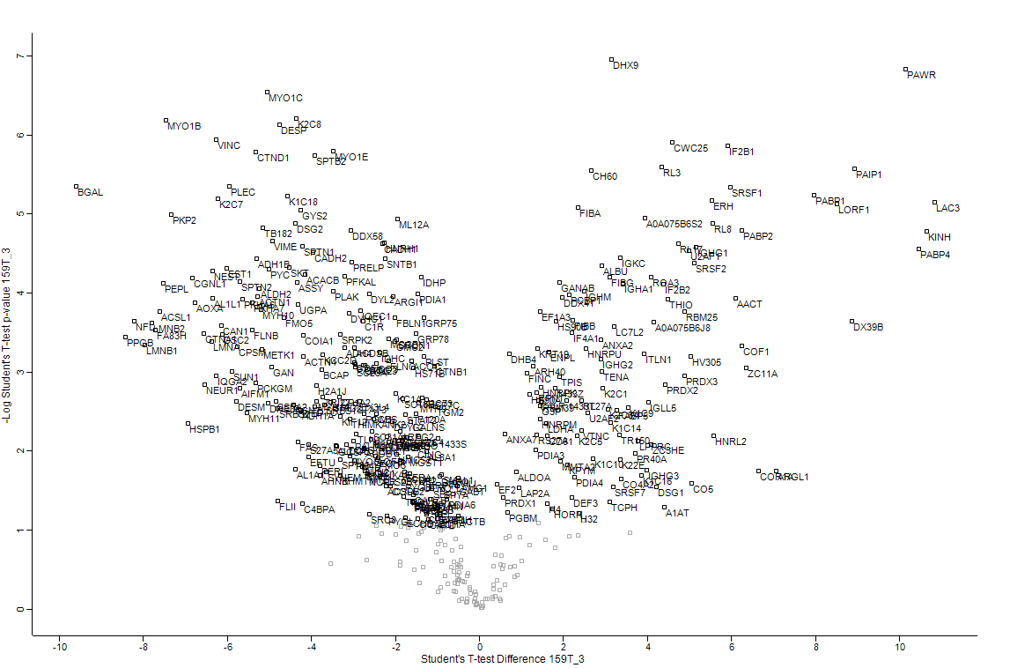
3 vs 5

Slide 11
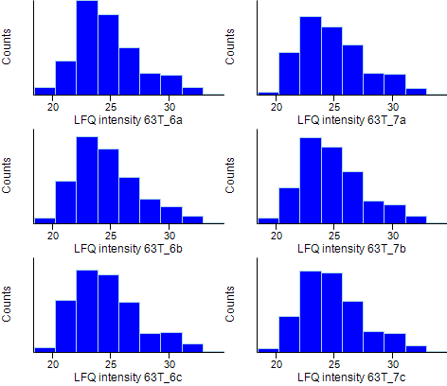
6 vs 7
Pre imputation histograms

Slide 12
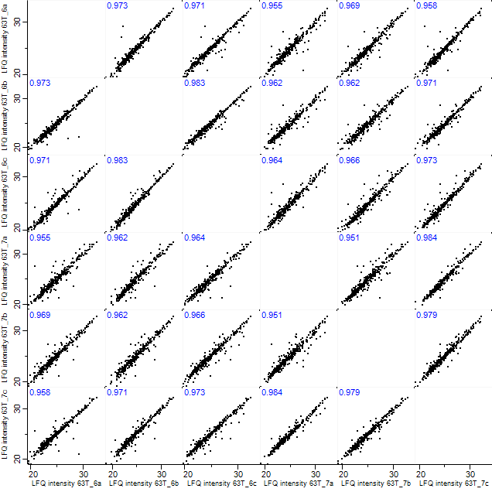
6 vs 7

Slide 13
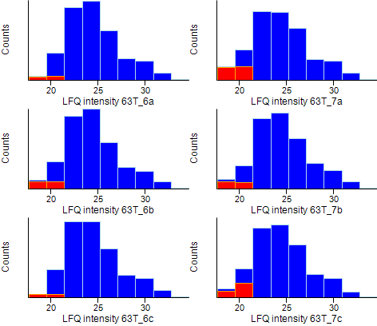
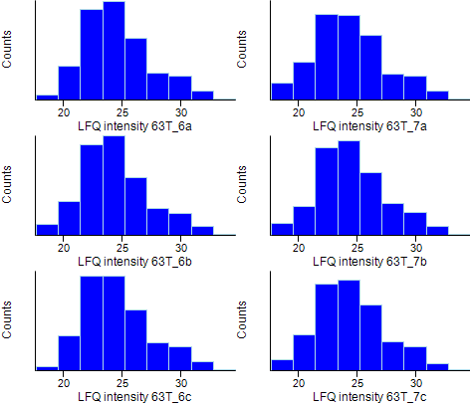
6 vs 7
Post imputation histograms (imputed in red)

Slide 14
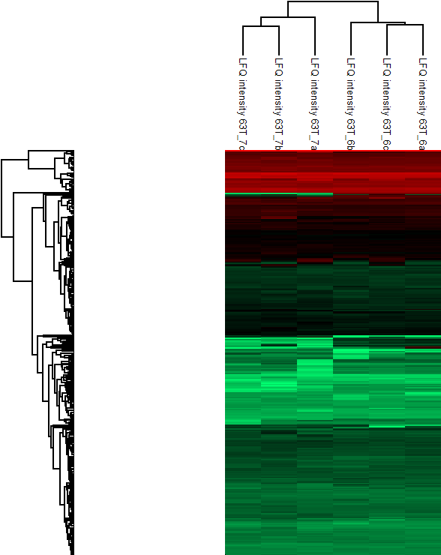
6 vs 7

Slide 15
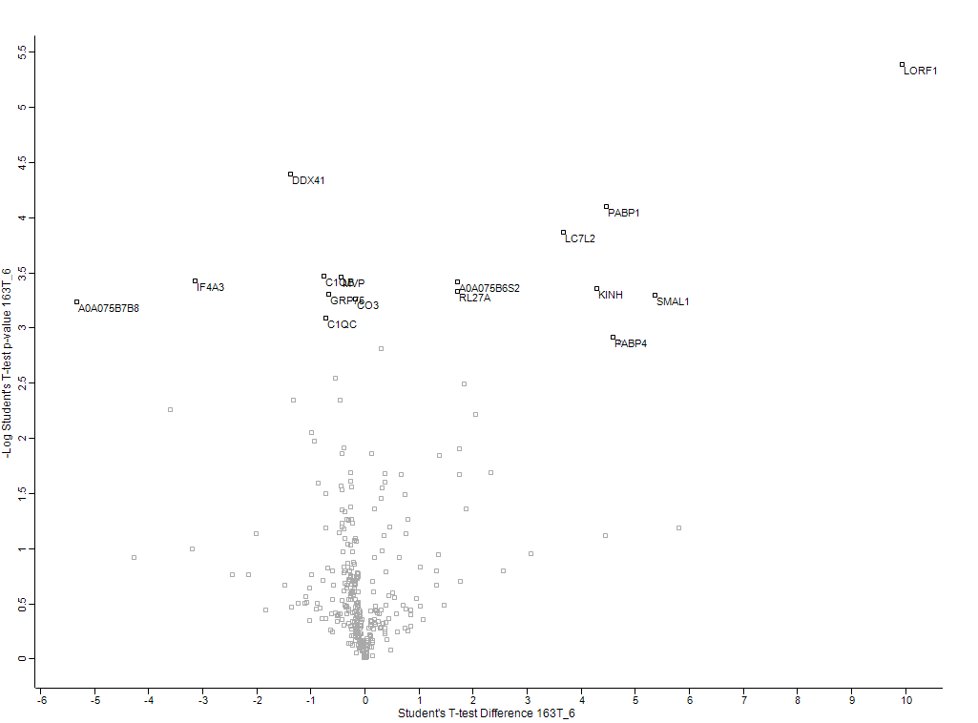
6 vs 7

Slide 16
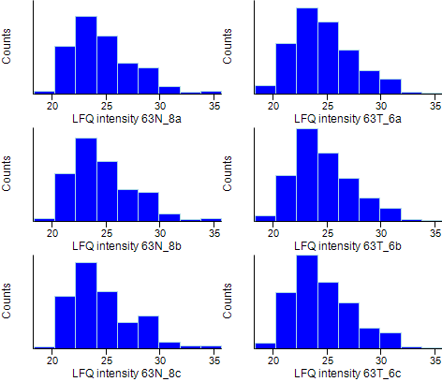
6 vs 8
Pre imputation histograms

Slide 17
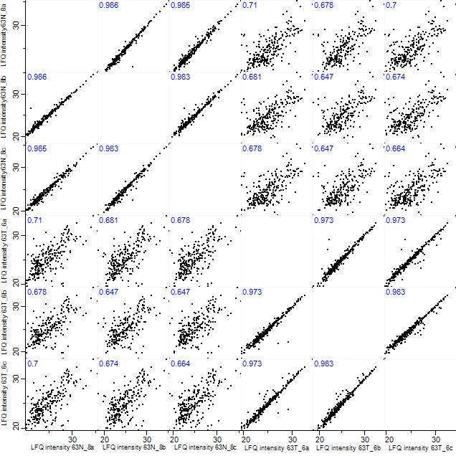
6 vs 8

Slide 18
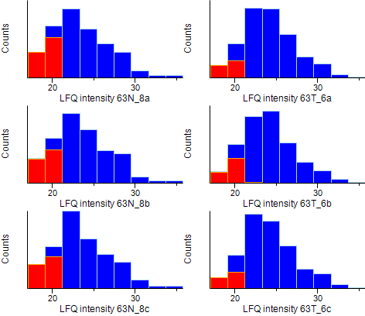
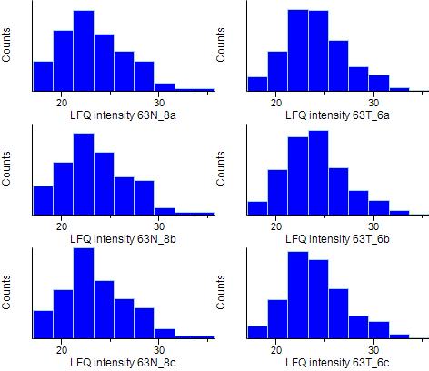
6 vs 8
Post imputation histograms (imputed in red)

Slide 19
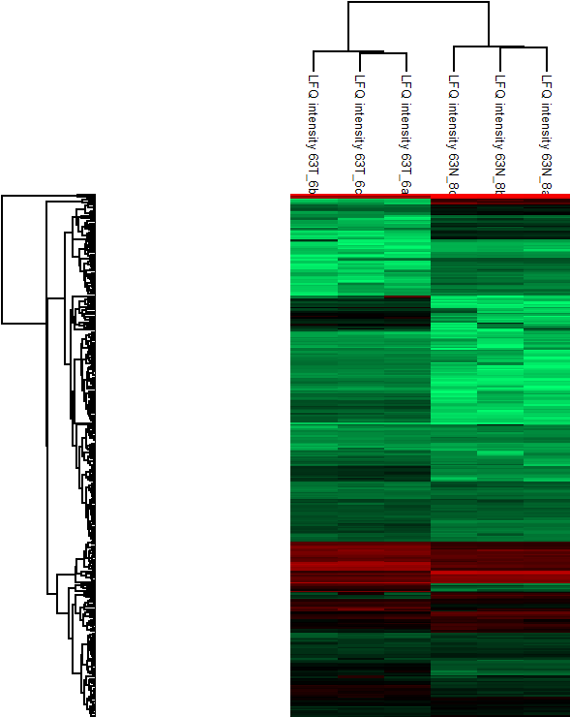
6 vs 8

Slide 20
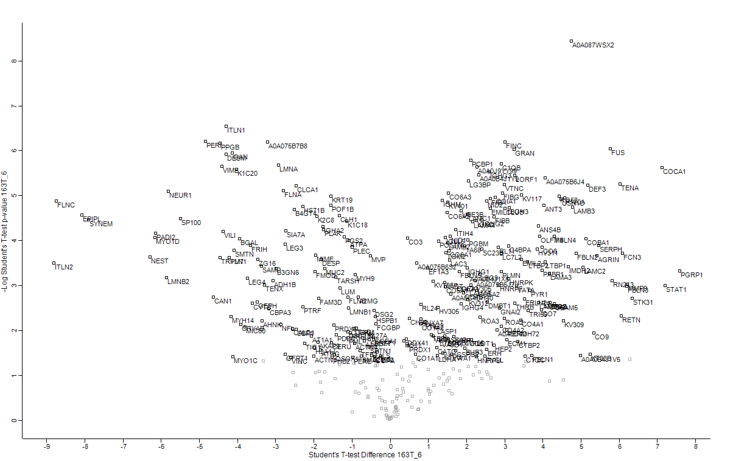
6 vs 8

Slide 21
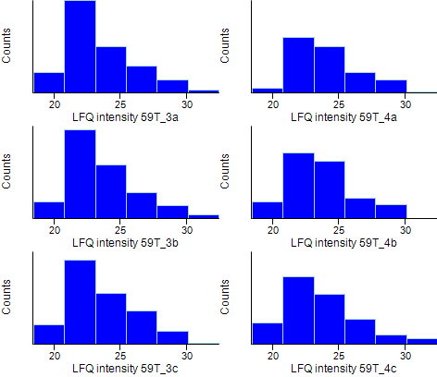
3 vs 4
Pre imputation histograms

Slide 22
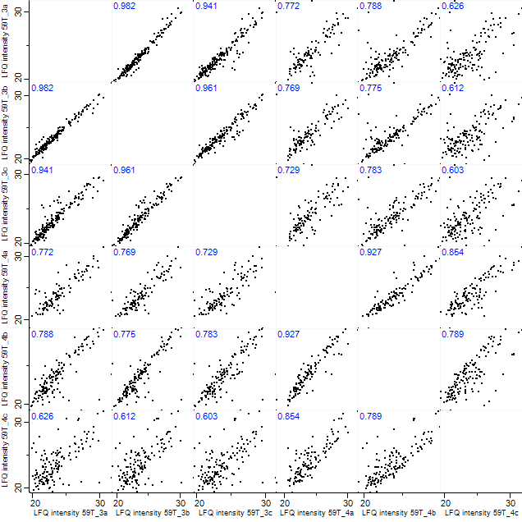
3 vs 4

Slide 23
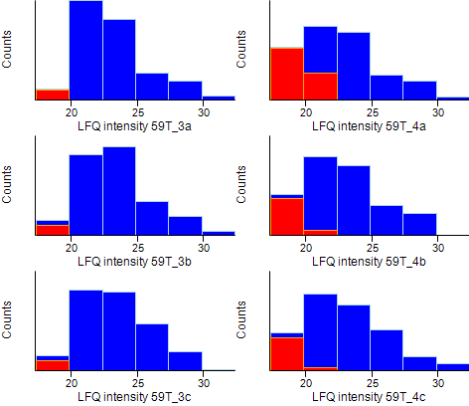
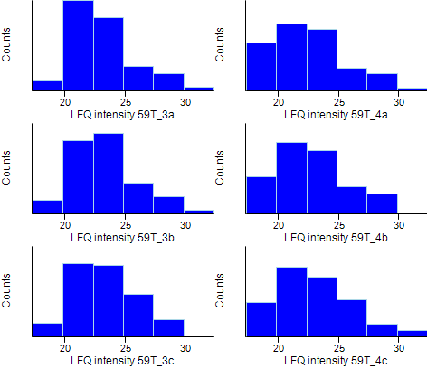
3 vs 4
Post imputation histograms (imputed in red)

Slide 24
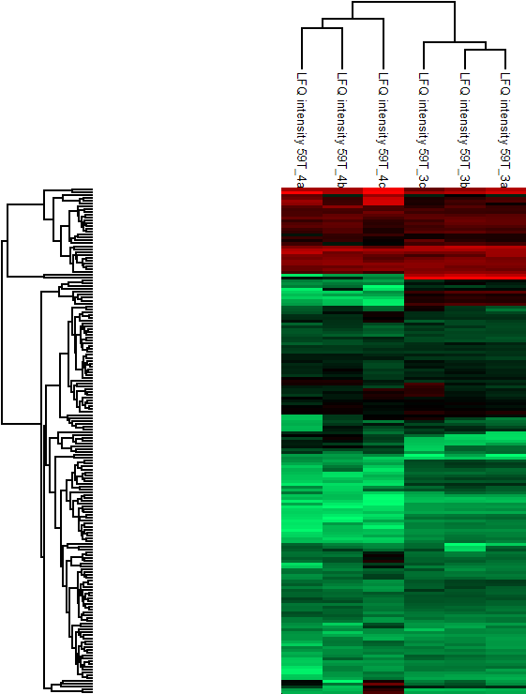
3 vs 4

Slide 25
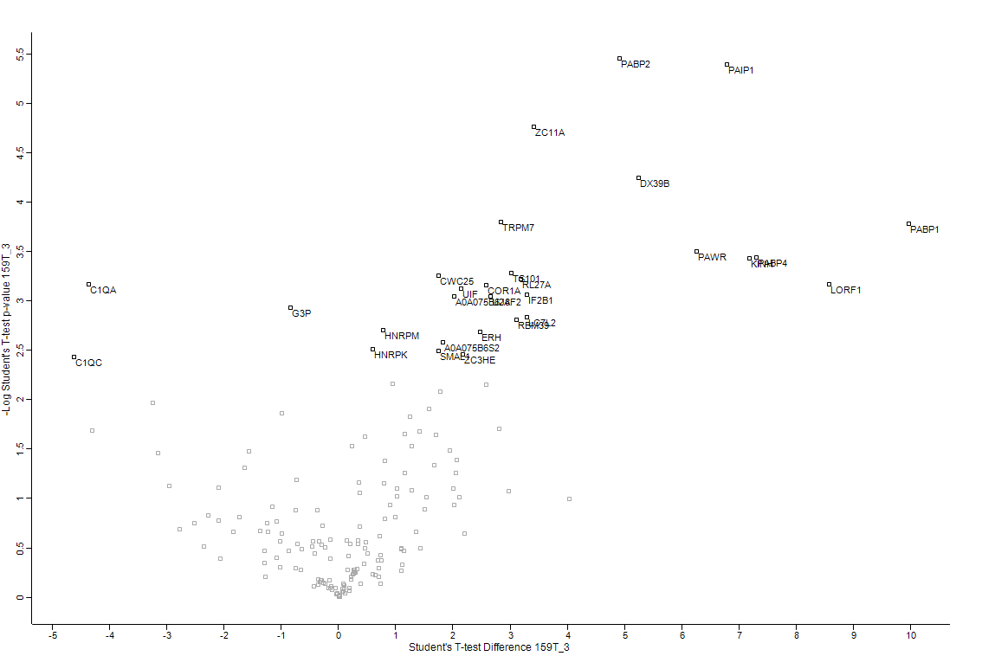
3 vs 4

